Slide 1
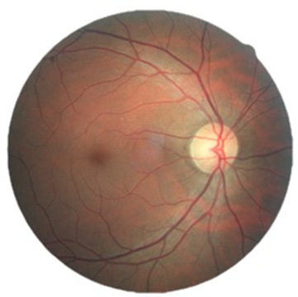
Diabetic Retinopathy Detection
Domains:
Machine Learning
Image Processing
Rudolph Almeida – 05
Niral Almeida – 04
Melissa D’Cunha - 20

Slide 2
What is the problem we plan to tackle?
Diabetic Retinopathy is the leading cause of blindness in the developing world
Diabetic Retinopathy is caused by long standing cases of diabetes
It can be stopped if it is detected in time
However, this is difficult as the disease shows little symptoms until it is too late
Currently DR detection requires a trained physician, in a manual and time-consuming process, to examine and evaluate digital color photographs of the retina
By the time human readers submit their reviews, often a day or two later, the delayed results lead to lost follow up, miscommunication, and delayed treatment.

Slide 3
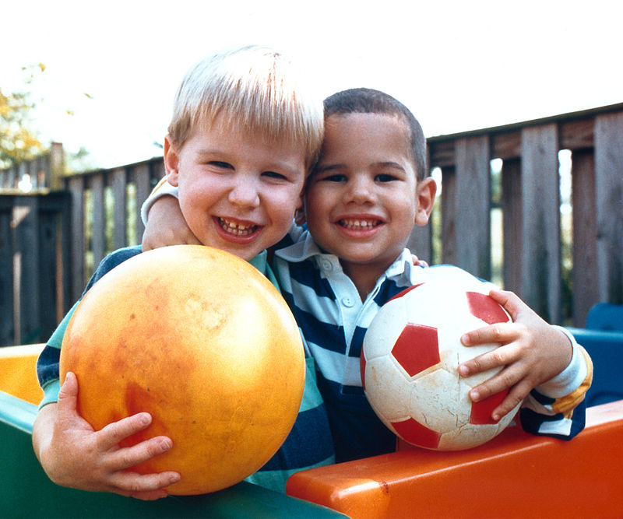
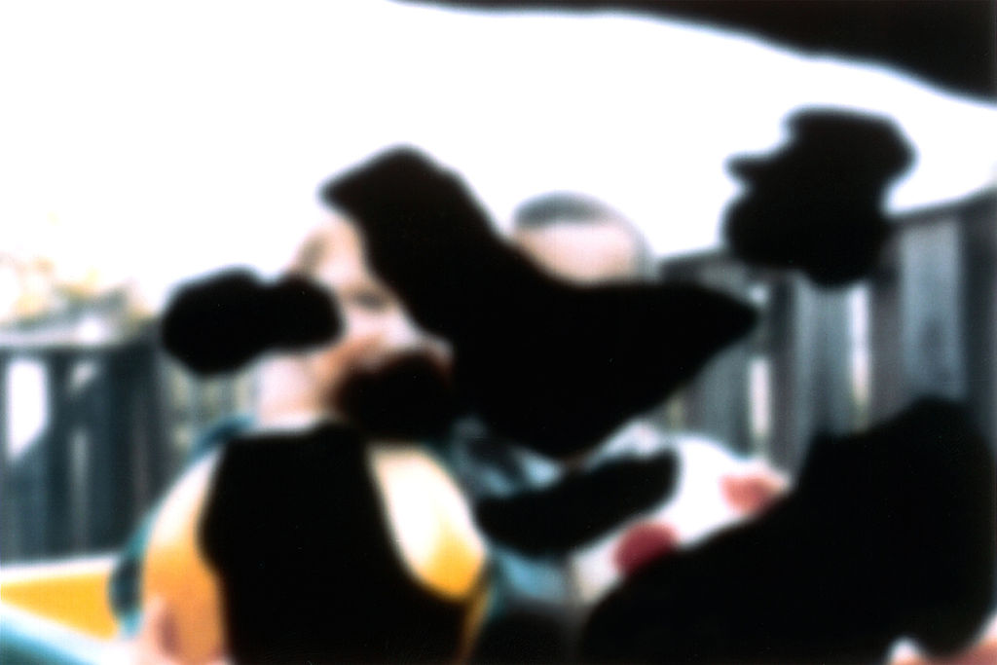
What is Diabetic Retinopathy?
NORMAL VISION
VISION WITH DIABETIC RETINOPATHY

Slide 4
How do we plan to tackle this problem?
We’ll be creating a system which has been trained to read “color fundus photographs” as input and producing a numerical output.
The numerical output will be on a scale of 0 – 4 where 0 represents NO DR and 4 represents PROLIFERATIVE DR
Our main aim is to improve upon the previous efforts which applied image classification, machine learning and pattern matching

Slide 5
Overview Of Algorithm – Convolutional Neural Nets
Convolutional Neural Nets have recently enjoyed great success in large scale image and video recognition
A CNN is comprised of one or more convolutional layers and then followed by one or more fully connected layers as in a standard multilayer neural network
The architecture is designed to take advantage of the 2D hierarchical structure of an input image

Slide 6
How will be the system used?
We’ll be preparing a desktop based application which will take in “color fundus” photographs of the left and right eye of the subject
The system will then evaluate the image, processing out any noise or irregularities
Then, based on what it has learnt in training, the system will produce a numerical output ranging from 0-4 and it’s corresponding label

Slide 7
What about existing systems?
There are increasing efforts to develop automated methods for DR detection using image processing, pattern recognition and machine learning methods
Most efforts have focused on creating automated systems that use the fundus photograph as input
While good progress has been made and automated systems are beginning to reach standards similar to those of clinicians, the examination of fundus photograph by experts still remains the gold standard.

Slide 8
THANK YOU…

